Slide 1
Capstone Project 1: Appliances Energy Prediction

Slide 2
Business Problem Description –
Dataset contains the house temperature and humidity conditions were monitored with a ZigBee wireless sensor network. As per the description on UCI website, each wireless node transmitted the temperature and humidity conditions around 3.3 min, Then, the wireless data was averaged for 10 minutes periods. The energy data was logged every 10 minutes with m-bus energy meters. Combining this data with the weather data based on the date time columns
To find the key feature from the dataset which contributes to the most and the
Predict the appliance energy consumption.
With collected data of temperature and humidity (indoor and outdoor) sensors.
Weather data collected
Fuel price over the period of time.
Best prediction model with best parameter for future prediction of the appliance Energy

Slide 3
Dataset Details –
There are 19735 and 30attributes. Key features from the dataset are
We have two data sets - energydata_complete.csv and CrudeOilPrice.csv. We have
taken two different dataset to get better prediction with analyzing the engorge consumed and how was the fuel price during the particular date.
We do not have any missing values in energydata_complete.csv; it has 19735 observation with 29 attributes pertaining to temperature, humidity, light, wind speed, dew, and visibility from local weather channel.
We do not have any missing value in CrudeOilPrice.csv, which has the fuel price for respective months and dates. This dataset has 2519 observation and 2 attributes of date and fuel price.

Slide 4
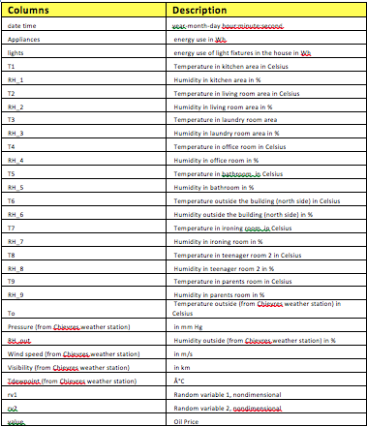
Dataset Details –
There are 19735 and 30attributes. Key features from the dataset are

Slide 5
Data Exploration –
The dataset is from 2016-01-11 and 2016-05-27; have data starting JAN to MAY of 2016. These are the temperature reading captured inside and outside the house. From the explored reading of each sensor is between 14.89 and 29.85 but ‘T6’ is between -6 and 28.29. The possible reason can be its reading are for outside.
There are Humidity related information as well in the dataset, from the explored reading of each sensor is between 20.46 to 58.79 but ‘RH_5’ and ‘RH_6’ has max of 96.32 and 99.9.
The max value is 1080wh, whereas 75% of usage is under 100wh. Some of the appliances has high consumption. These can be outliers but, currently keeping them as part of the dataset and not dropping them from the dataset.
If we see the statistics for Appliance Attributes, the minimum value is 10 and max value is 1080, and the mean is 97.69 and 75% of records are below 100 KWH. This column has outliers and we will keep them and check during our modeling.
Data Preprocessing –
When merging the two datasets, in energydata dataset, date is a timestamp and
in crudeoilprice dataset, date is a date datatype, so we have to normalize the date, in order for us to merge the two datasets.
After the merge, we observe that “ values" columns is merged on the dataset, but it doesn’t have all the dates values and 5904 records has null values.
To solve these null values, we used the “forward fill” method and value column was populated with previous day values for the records, which were null and renamed the column to "oilprice".
The total number of observation is 19735 and 30 Attributes.

Slide 6
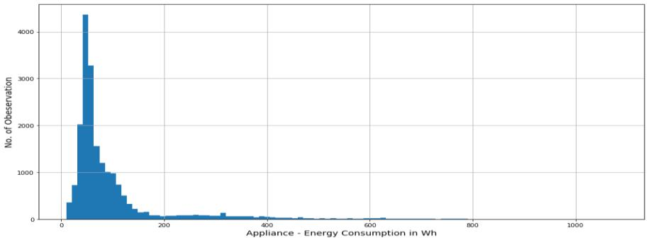
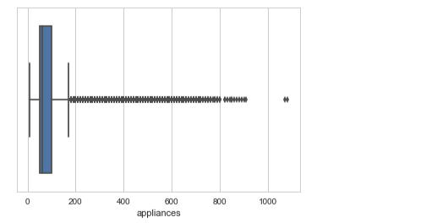
Data Dimensions
On the Target Attribute – Appliance, the below histograms is rightly skewed and most of the data is with 200 KWh.

Slide 7
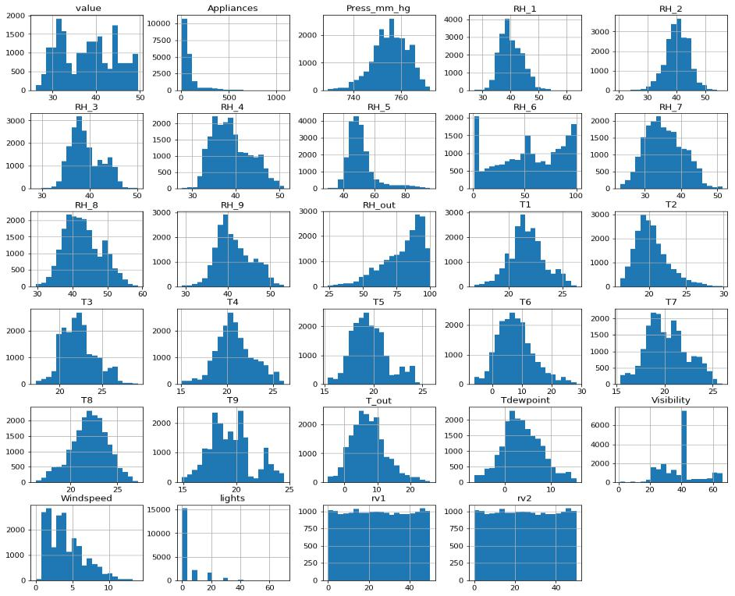
Feature Distribution - Histogram

Slide 8
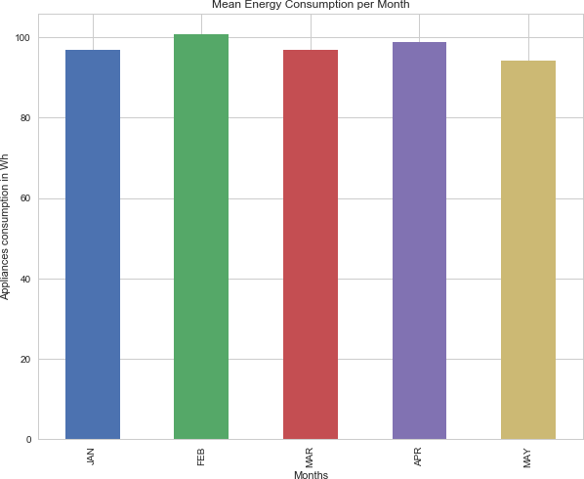
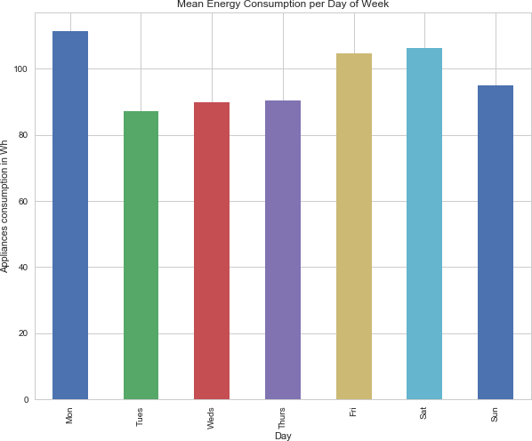
Data Visualition-
With taking the average on week – Monday the usage has been higher, followed by Saturday and Friday.
For Monthly Average – On a average, February and April the consumption has been more than other months

Slide 9
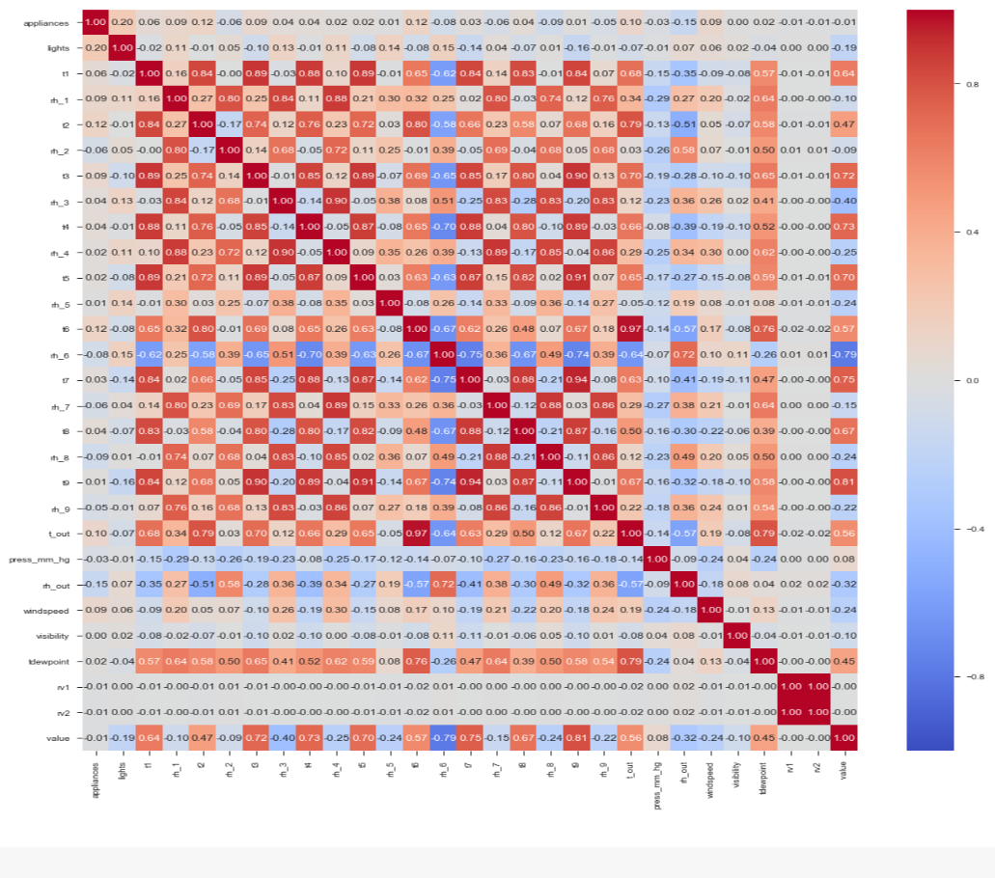
Correlation Plot -

Slide 10
Correlation between Temperature features –
Correlation between T9 and T1 pearson 0.84 0.00 None
Correlation between T9 and T2 pearson 0.68 0.00 None
Correlation between T9 and T3 pearson 0.90 0.00 None
Correlation between T9 and T4 pearson 0.89 0.00 None
Correlation between T9 and T5 pearson 0.91 0.00 None
Correlation between T9 and T6 pearson 0.67 0.00 None
Correlation between T9 and T7 pearson 0.94 0.00 None
Correlation between T9 and T8 pearson 0.87 0.00 None
linear relation between 'T6' and T_out'

Slide 11
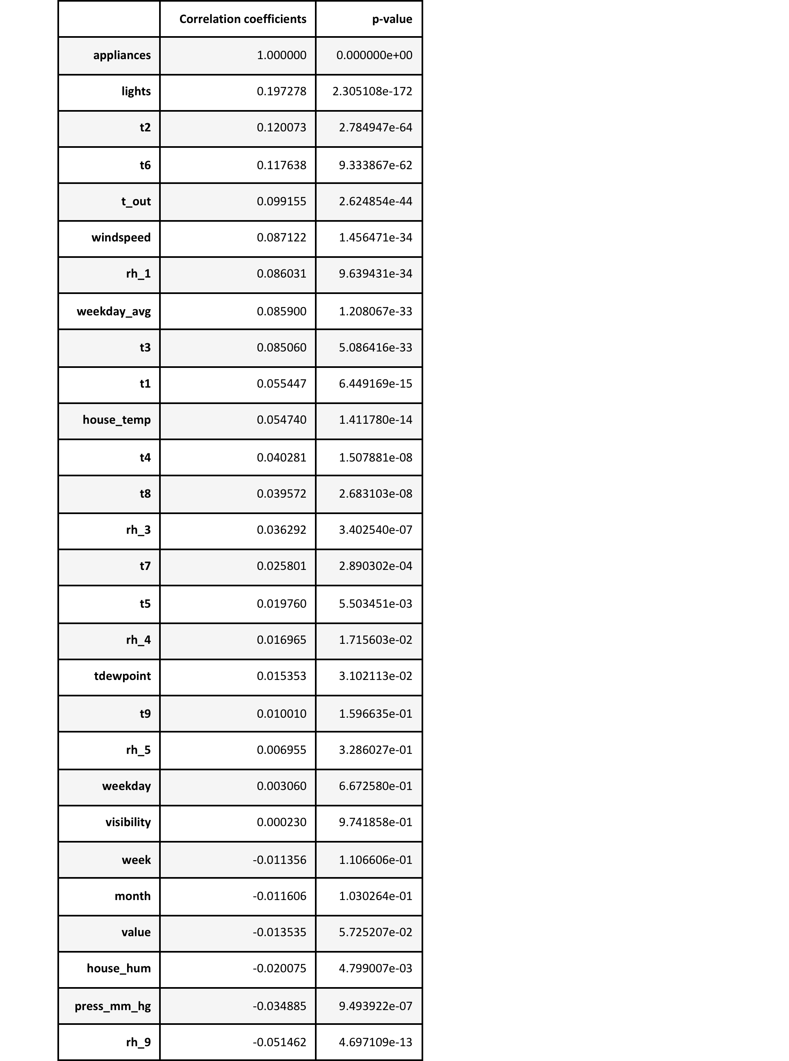
Correlation and p_value with Appliance (Target Feature)

Slide 12
Statistics with OLS model
Coefficient table (middle table). We can interpret the t1+t2+t3+t4+t5+t6+t7+t8+rh_1+rh_2+windspeed, coefficient (9.0446, -25.6614, 17.7293,-1.4768,-7.3830,-7.5650,1.0356,-6.2685,9.4475,20.0347,-20.3286,1.6784) by first noticing that the p-value (under P>|t|) is so small, basically zero. This means that the t6 is a statisticall significant predictor of appliance energy consumption.
The confidence interval of t3 gives us a range of plausible values for this average change, about (15.814 and 19.644)
R^2 is only 0.098 better than previous, F-Statistic The F-Statistic is 194.5 and the probability for this statistic is 0. We can safely reject the null hypothesis, indicating that at least one 𝛽 coefficient is nonzero.

Slide 13
Major Inference –
Temperature feature from T1-T9 and T_out have positive correlation with the target Appliances. For the indoor temperatures, the correlations are high as expected. Four columns have a high degree of correlation with T9 & T3,T5,T7,T8 also T6 & T_Out has high correlation (both temperatures from outside) . Hence we can remove the T9 and T_out from the model in next section.
Weather attributes - Visibility, Tdewpoint, Press_mm_hg have low correlation values
Humidity - There are no significantly high correlation cases for humidity sensors.
Random variables have no role to play; hence we will remove these features from the model in next section.

Slide 14
Model Building and Implementation
As identified earlier – we are dropping the below field –
'date_x', 'appliances','rv1', 'rv2','t6','t9' from the dataset.
Created the X will all the features and Y with the target feature.
Using train_test_split method, we have done the split of the dataset in 70% Training data and 30% test data.
Upon running the Linear regression model- we get the below score for R^2 and RMSE(Root Mean Square Error)
Also, with Cross validation, we didn’t see the improvement in the performance of the benchmark algorithms –
Now, we will try to scale the data and find best performing model –
Dropped the x_date feature from the dataset, and using the StandardScaler method, scaled the dfactual dataframe.
From the scaled dataset, dropped the 'appliances','rv1', 'rv2','t6','t9'.
Created the Training and Test Dataset with 70-30% ratio.

Slide 15
Algorithms -
Create the following models with key important features –
Regularized linear models as an improvement over Linear Regression.
Ridge Regression
Lasso Regression
Ensemble based Tree Regression models, which deal with number of features and outlier data.
Random Forests
Gradient Boosting
Extra Trees
Neural networks for non-linear relationships target feature and predictors.
Multi-Layer Perceptron

Slide 16
Outcome from Algorithm -
Implemented them in a iterative manner with creating different functions
Created function to capture the fit and predict the models and capture the score and accuracy for the models
Created the pipeline and passed all the algorithms to be executed in the above function.
Created a function to display and store the results / outcome.
Below is the results displaying the R^2 and RMSE and time it took to predict.

Slide 17
Interpretation After Hyper Tuning-
Hyper-parameter tuning the best Model – “ExtraTreesRegressor” observed from above step – Using the RandomizedSearchCV, we will find the best estimators and using those estimators we will perform the prediction
Interpretation from Implementation -
R2 score improvement compared to Benchmark model = 0.463.
RMSE improvement compared to Benchmark model = 0.301.
R2 score improvement compared to without tuned model = 0.086.
RMSE improvement compared to without tuned model = 0.066.

Slide 18
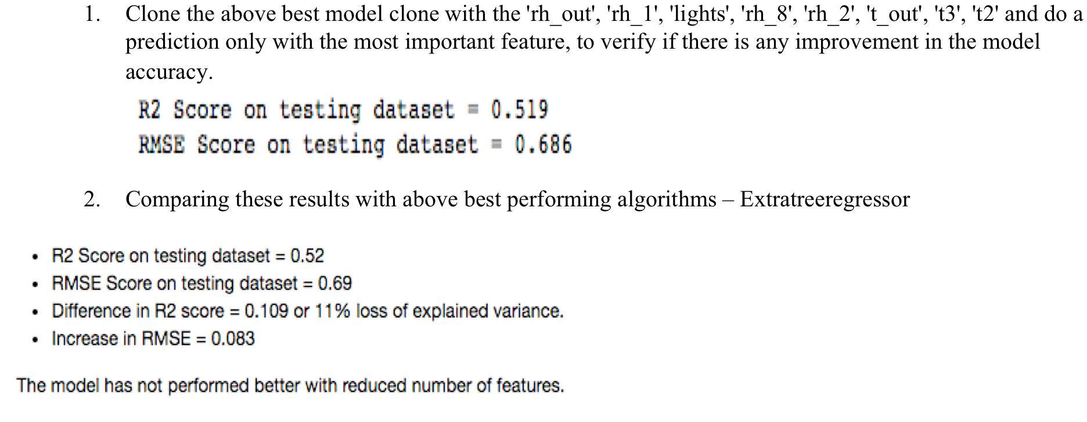
Important Features

Slide 19
Conclusion -
Best Algorithm is ExtraTreesRegressor.
Top 5 most important features:- rh_out, rh_1, lights, rh_8, rh_2
Variance explained on test set = 63%.
RMSE error = 60.3%
R2 score improvement compared to Benchmark model = 0.463.
RMSE improvement compared to Benchmark model = 0.301.
R2 score improvement compared to without tuned model = 0.086.
RMSE improvement compared to without tuned model = 0.066.

